Slide 1

TokoBli E-Commerce ROI Performance Analysis
by Ahmad Rizki
March 3, 2025
RevoU FSDA batch FEB25
www.linkedin.com/in/arizabdulhanan

Slide 2
Brief
TokoBli is the largest e-commerce company in Indonesia. With a large variety of product types, they must be able to manage which product are profitables. And also the company need to analyze the existing opportunities in order to compete with competitors, such as sales campaign on a certain date which was held on October 10, November 11, and December 12.
To optimize the upcoming campaign, the company need to evaluating and deriving insights from the three previous campaigns with each scenario. The main metrics that need to be analyzed are the campaign budget for discounts, number of transactions, number of customers, number of products sold, and amount revenue during campaign.

Slide 3
1. Business Understanding
Question
A. What is the core business questions faced by TokoBli?
Answer
Which campaign scenarios that yields the best results from the three scenarios which already held on October 10, November 11, and December 12 ?
Because we want to optimize the upcoming campaign, and need to evaluating and deriving insights from the three previous campaigns with each scenario. The best results means, that campaign achieve the most optimal revenue and transactions while minimizing the campaign budget.
Notes:
ekspektasi (stakeholder) dan realita (problem karena tidak mencapai ekpektasi) dari organisasi dalam mengevaluasi , identifikasi (apa yang diharapkan stakeholder) dan mapping (bahan apa yang diberikan (dataset)), business problem

Slide 4
1. Business Understanding
Question
B. What is the other business questions faced by TokoBli?
Answer
Is there any correlation between campaign budget for discount with quantity, price, and total revenue ?
Because we want to know if the strategy in providing discount for all transactions will result an increase in the number of transaction, customer, products sold, or total revenue.
Notes:
ekspektasi (stakeholder) dan realita (problem karena tidak mencapai ekpektasi) dari organisasi dalam mengevaluasi , identifikasi (apa yang diharapkan stakeholder) dan mapping (bahan apa yang diberikan (dataset)), business problem

Slide 5
1. Business Understanding
Question
C. What is the other business questions faced by TokoBli?
Answer
Which product category was the best-selling and generated the highest transactions, customers, products sold, and revenue while also having the lowest discount campaign budget ?
Because we want to know which products we should focus more on to give discounts to increase the number of transactions, customers, products sold, and revenue while also having the lowest discount campaign budget.
Notes:
ekspektasi (stakeholder) dan realita (problem karena tidak mencapai ekpektasi) dari organisasi dalam mengevaluasi , identifikasi (apa yang diharapkan stakeholder) dan mapping (bahan apa yang diberikan (dataset)), business problem

Slide 6
1. Business Understanding
Question
D. What is the other business questions faced by TokoBli?
Answer
What is the best method of selecting product category that that will given a discount ?
Because we want to know which products we should focus more on to give discounts to increase the number of transactions, customers, products sold, and revenue while also having the lowest discount campaign budget.
Notes:
ekspektasi (stakeholder) dan realita (problem karena tidak mencapai ekpektasi) dari organisasi dalam mengevaluasi , identifikasi (apa yang diharapkan stakeholder) dan mapping (bahan apa yang diberikan (dataset)), business problem

Slide 7
1. Business Understanding
Question
E. What is/are the statistics that you think is/are best to answer business questions in point A ?
Answer
Return on Investment (ROI), Number of Transactions, Numbers of Customers, and Number of Products Sold is the best statistic to answer business question in point A. ROI could capture ratio campaign budget for discount and amount of revenue. This statistic could compare number of ROI, transactions, customers, products sold, and discount amount per item sold, so we could understand which campaign has yields the best results.
Notes:
ekspektasi (stakeholder) dan realita (problem karena tidak mencapai ekpektasi) dari organisasi dalam mengevaluasi , identifikasi (apa yang diharapkan stakeholder) dan mapping (bahan apa yang diberikan (dataset)), business problem

Slide 8
2. Clean Up The Data
Question
A. Remove / Imput rows and columns with missing data ?
Answer
Remove status columns due to missing value > 50%
Imput missing value on price columns for ID 147 with Rp. 2,500,000.00
Imput missing value on qty columns for ID 152 with 1
Imput missing value on discount columns for ID 177 with Rp. 199,000.00
Notes:
ekspektasi (stakeholder) dan realita (problem karena tidak mencapai ekpektasi) dari organisasi dalam mengevaluasi , identifikasi (apa yang diharapkan stakeholder) dan mapping (bahan apa yang diberikan (dataset)), business problem

Slide 9
2. Clean Up The Data
Question
B. Remove columns with irrelevant data ?
Answer
Remove payment method columns due to irrelevant data
Notes:
ekspektasi (stakeholder) dan realita (problem karena tidak mencapai ekpektasi) dari organisasi dalam mengevaluasi , identifikasi (apa yang diharapkan stakeholder) dan mapping (bahan apa yang diberikan (dataset)), business problem

Slide 10
2. Clean Up The Data
Question
C. Remove rows with duplicated ?
Answer
Remove duplicates for ID 164, ID 269, ID 303, ID 546, and ID 12769
Notes:
ekspektasi (stakeholder) dan realita (problem karena tidak mencapai ekpektasi) dari organisasi dalam mengevaluasi , identifikasi (apa yang diharapkan stakeholder) dan mapping (bahan apa yang diberikan (dataset)), business problem

Slide 11
2. Clean Up The Data
Question
D. Change data type of columns that is not suitable ?
Answer
Change type of date format on created at columns to make it easier to read
Ensure SKU columns value already with UPPER format
Change type of number on price columns into accounting format
Change type of number on discount columns into accounting format
Change type of number on total revenue columns into accounting format
Notes:
ekspektasi (stakeholder) dan realita (problem karena tidak mencapai ekpektasi) dari organisasi dalam mengevaluasi , identifikasi (apa yang diharapkan stakeholder) dan mapping (bahan apa yang diberikan (dataset)), business problem

Slide 12
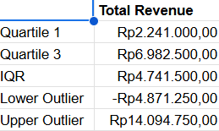
3. Descriptive Analysis
Question
A. Eliminate outliers data based on column “Total Revenue” (if needed)
Answer
There is an outliers with ID number ID 273, ID 304, ID 328, ID 332, ID 346, ID 353, ID 370, ID 371, ID 429, ID 451, ID 838, and ID 11849 which has a lower outlier value 0 and upper outlier value Rp. 14,094,750.00.
After eliminate the outliers, remaining data is 10,142 rows.
Notes:
ekspektasi (stakeholder) dan realita (problem karena tidak mencapai ekpektasi) dari organisasi dalam mengevaluasi , identifikasi (apa yang diharapkan stakeholder) dan mapping (bahan apa yang diberikan (dataset)), business problem

Slide 13
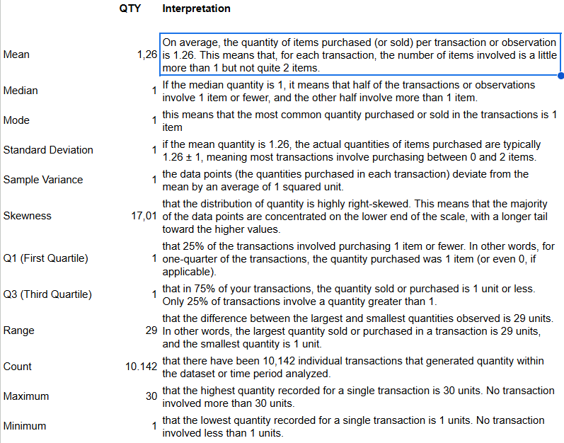
3. Descriptive Analysis
Question
Answer
B. Create Statistical measurement on Qty, Discount, and Total Revenue to know data distribution by using : Count, etc.
Spreadsheets Link
Notes:
ekspektasi (stakeholder) dan realita (problem karena tidak mencapai ekpektasi) dari organisasi dalam mengevaluasi , identifikasi (apa yang diharapkan stakeholder) dan mapping (bahan apa yang diberikan (dataset)), business problem

Slide 14
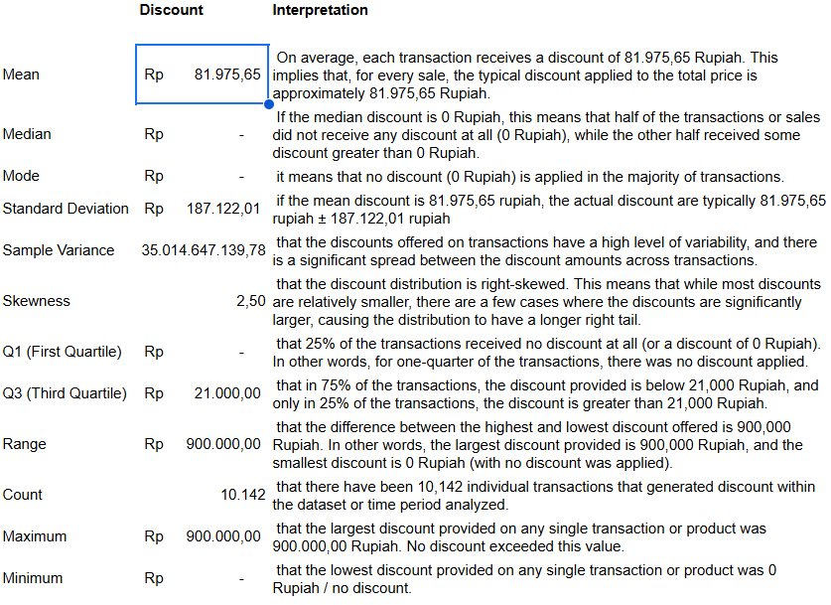
3. Descriptive Analysis
Question
Answer
B. Create Statistical measurement on Qty, Discount, and Total Revenue to know data distribution by using : Count, etc.
Spreadsheets_Link
Notes:
ekspektasi (stakeholder) dan realita (problem karena tidak mencapai ekpektasi) dari organisasi dalam mengevaluasi , identifikasi (apa yang diharapkan stakeholder) dan mapping (bahan apa yang diberikan (dataset)), business problem

Slide 15
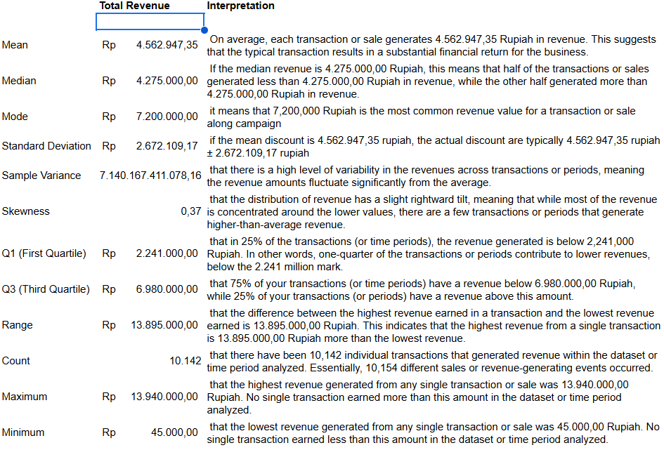
3. Descriptive Analysis
Question
Answer
B. Create Statistical measurement on Qty, Discount, and Total Revenue to know data distribution by using : Count, etc.
Spreadsheets_Link
Notes:
ekspektasi (stakeholder) dan realita (problem karena tidak mencapai ekpektasi) dari organisasi dalam mengevaluasi , identifikasi (apa yang diharapkan stakeholder) dan mapping (bahan apa yang diberikan (dataset)), business problem

Slide 16
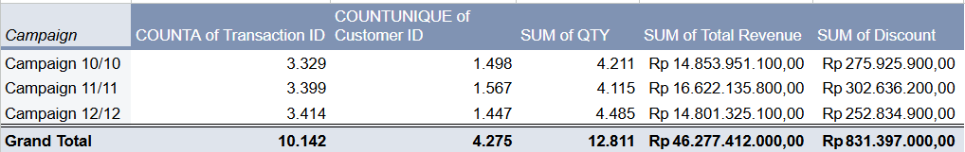
4. EDA & Statistical Measurement
Question
A. Is there a difference in total transactions, total customers, total products sold, total revenue and total discount campaign budget between the three campaign periods ? Explain the insights.
Answer
The insights :
Campaign 12/12 has the largest number of Transaction Number, Customer Number, and quantity number
Campaign 12/12 has the lowest budget of discount among the three scenarios
Campaign 12/12 has the lowest of discount percentage per transaction among the three scenarios
Campaign 11/11 has the highest total revenue
The correlation result about Price vs Discount on Descriptive Statistics with a correlation coefficient 0.17, are inline with comparison between Avg. price and Avg. discount percentage for all campaign
Please click Link to see the diagram.
Notes:
ekspektasi (stakeholder) dan realita (problem karena tidak mencapai ekpektasi) dari organisasi dalam mengevaluasi , identifikasi (apa yang diharapkan stakeholder) dan mapping (bahan apa yang diberikan (dataset)), business problem

Slide 17
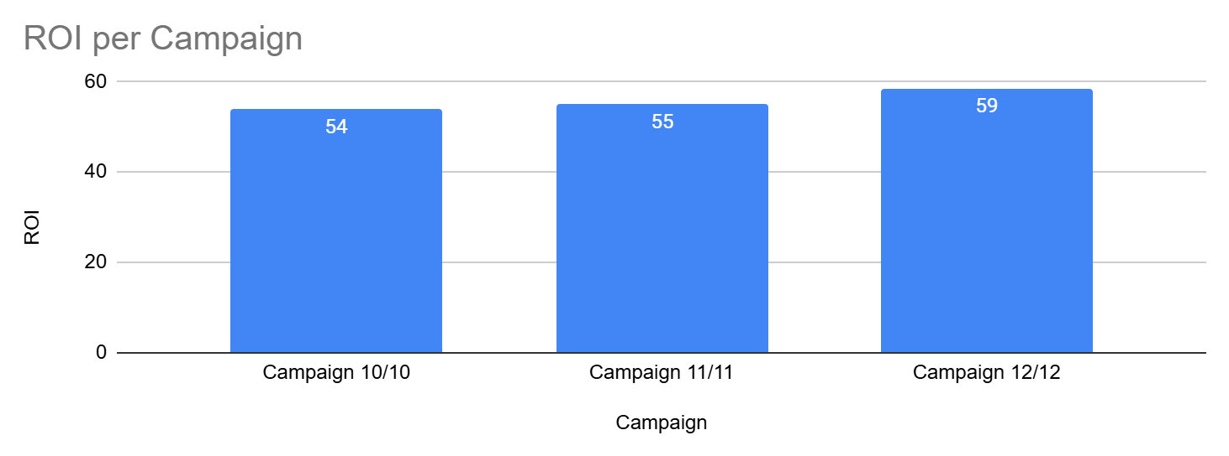
4. EDA & Statistical Measurement
Question
B. Is there a difference in the ratio revenue and discount campaign budget between the three campaign periods ? Explain the insights.
Answer
The insights :
Campaign 12/12 has the highest ROI, even with the lowest of total revenue achieved and avg. revenue per campaign
Campaign 12/12 has the lowest avg.cost per campaign
Excluding the transaction with no discount, Campaign 12/12 has the lowest transaction number that given discount and also has the lowest on avg. discount per Campaign
Campaign 12/12 can achieve the highest ROI by being efficient in giving discounts, but still can make the highest number of transaction, customer, and product sold
Please click Link to see the diagram.
Notes:
ekspektasi (stakeholder) dan realita (problem karena tidak mencapai ekpektasi) dari organisasi dalam mengevaluasi , identifikasi (apa yang diharapkan stakeholder) dan mapping (bahan apa yang diberikan (dataset)), business problem

Slide 18
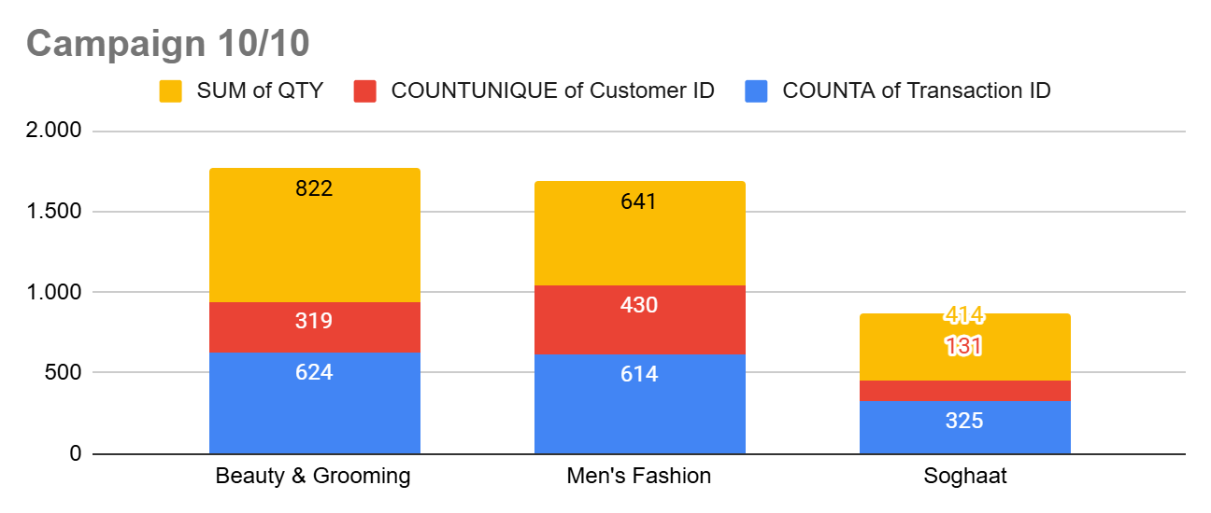
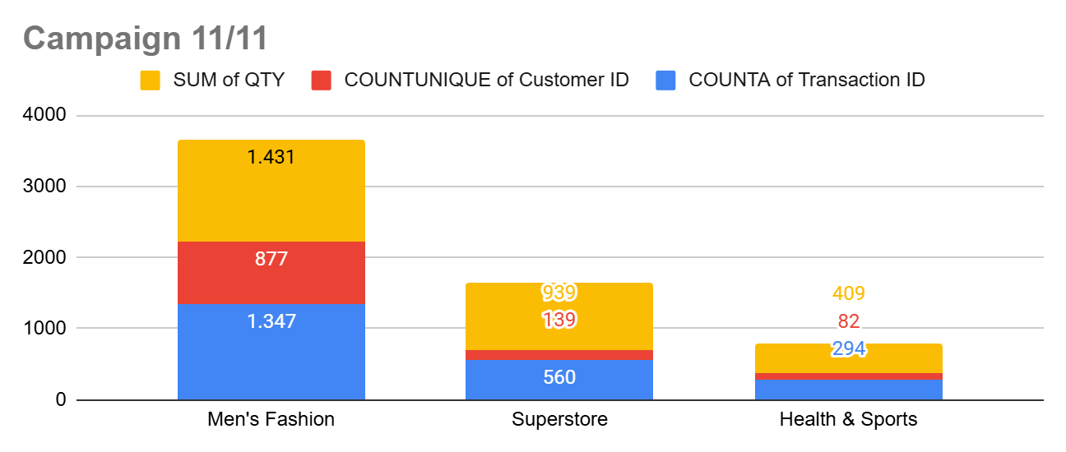
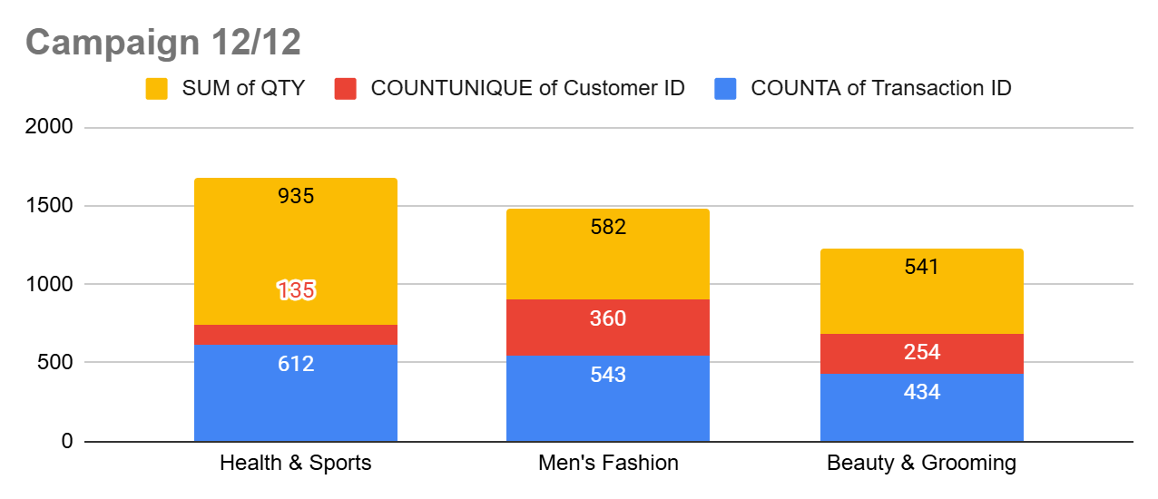
4. EDA & Statistical Measurement
Question
C. Which product category was the best selling and generated the highest transactions, customers, products sold, and revenue while also having the lowest discount campaign budget, across the three campaign periods ? Explain the insights.
Answer
The insights :
Men's Fashion category has the highest on transaction number, customer number, quantity number, and amount of total revenue, and also has the lowest budget of discount among of all three campaigns
Average of discount percentage per transaction for Men's fashion is below 1.25% for all campaign
Campaign 12/12 can achieve the highest ROI with selecting a product that are given discount which has a high quantity per transaction and also has a low price, eventhough men's fashion is not include in priority product that get discount
Many transactions of men's fashion category is not given discount
Please click Link to see the diagram.
Notes:
ekspektasi (stakeholder) dan realita (problem karena tidak mencapai ekpektasi) dari organisasi dalam mengevaluasi , identifikasi (apa yang diharapkan stakeholder) dan mapping (bahan apa yang diberikan (dataset)), business problem

Slide 19
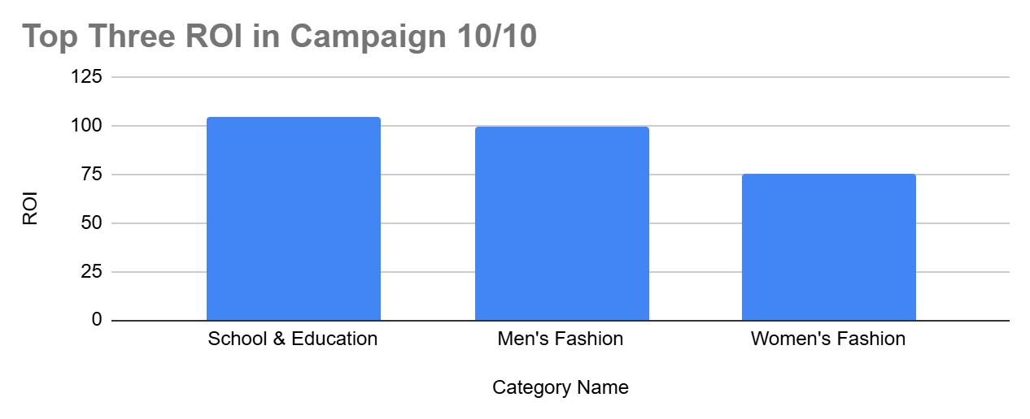
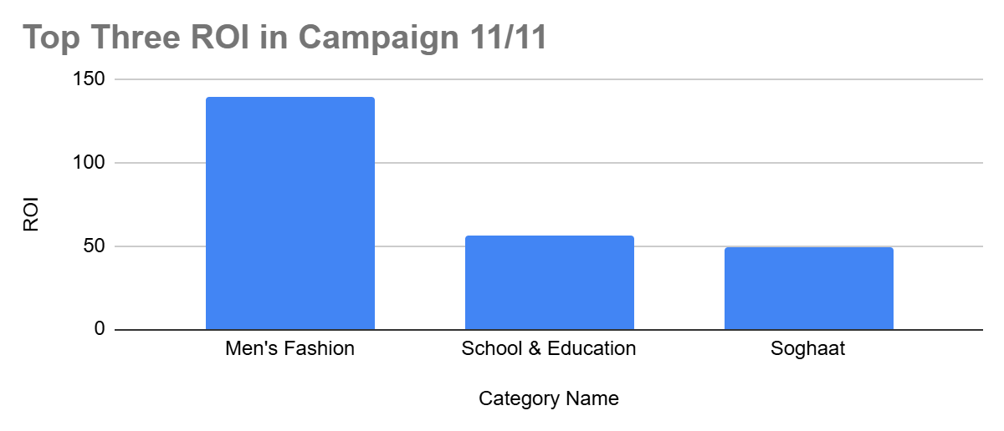
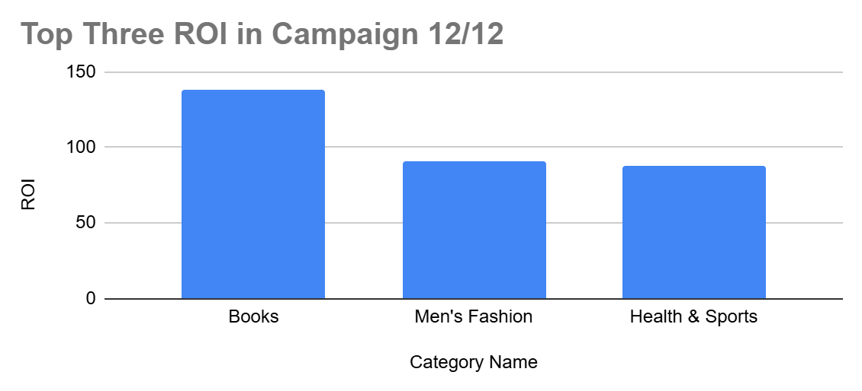
4. EDA & Statistical Measurement
Question
D. What product category received the highest ratio revenue and discount campaign budget from the three campaign periods ? Explain the insights.
Answer
The insights :
Men's fashion category always in top three of the highest ROI among all campaign
Based transaction that given a discount, Campaign 12/12 focus to give a discount on the Beauty & Grooming, Superstore, and Health & Sports category, as it has high quantity sales volume, so the discount cost per item will be smaller and be more efficient. Consider focusing discounts on these high-volume category for greater returns.
Based on data, campaign 12/12 give a low discount to product that has high sales volume per transaction with low of price
Please click Link to see the diagram.
Notes:
ekspektasi (stakeholder) dan realita (problem karena tidak mencapai ekpektasi) dari organisasi dalam mengevaluasi , identifikasi (apa yang diharapkan stakeholder) dan mapping (bahan apa yang diberikan (dataset)), business problem

Slide 20
4. EDA & Statistical Measurement
Question
E. What is the business recommendation based on EDA & Statistical Measurements ?
Answer
The recommendation :
Since campaign 12/12 has the highest ROI among all campaign, companies should apply the same strategy as the strategy in the Campaign 12/12 in creating the next campaign which focuses on providing discounts based on product with high quantity product sold per transaction and also has a low price, because the quantity of products sold for product with low prices tends to be large if a discount is given.
Focus your discount strategies on the Beauty & Grooming, Superstore, and Health & Sports category, as it has high quantity sales volume, so the discount cost per item will be smaller and be more efficient. Consider focusing discounts on these high-volume category for greater returns.
The company should allocate a larger portion of the discount budget to Men’s Fashion, as it is already demonstrating excellent ROI. This strategic shift could drive further sales without needing to increase the total discount budget dramatically. By concentrating on this category with continuing to provide discounts with a minimum quantity order per transaction.
Analyze categories with low sales volume and avoid offering discounts unless there is a clear opportunity to increase their market penetration.
Notes:
ekspektasi (stakeholder) dan realita (problem karena tidak mencapai ekpektasi) dari organisasi dalam mengevaluasi , identifikasi (apa yang diharapkan stakeholder) dan mapping (bahan apa yang diberikan (dataset)), business problem

Slide 21
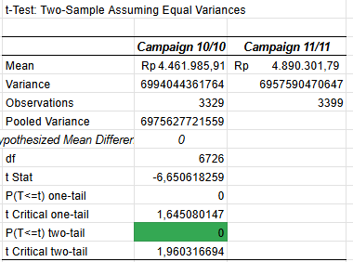
5. Hypothesis Testing
Question
A. Is there any significant difference between campaign 10/10 and campaign 11/11 Total Revenue ?
Answer
1. Hypothesis :
H0: There is no significant difference in total revenue between Campaign 10/10 and Campaign 11/11
H1: There is significant difference in total revenue between Campaign 10/10 and Campaign 11/11
2. Alpha (0.05 or 5%)
3. Statistical Test (t-Test)
Notes:
ekspektasi (stakeholder) dan realita (problem karena tidak mencapai ekpektasi) dari organisasi dalam mengevaluasi , identifikasi (apa yang diharapkan stakeholder) dan mapping (bahan apa yang diberikan (dataset)), business problem

Slide 22
5. Hypothesis Testing
Question
A. Is there any significant difference between campaign 10/10 and campaign 11/11 Total Revenue ?
Answer
4. Conclusion
P Value (0.00%) < Alpha (5%)
Based on the calculation p-value is below 0.05, which means that we reject H0
Meaning, there is significant difference in total revenue between Campaign 10/10 and Campaign 11/11
5. Insights
There is a significant increase between mean value of Campaign 10/10 with mean value of Campaign 11/11.
Notes:
ekspektasi (stakeholder) dan realita (problem karena tidak mencapai ekpektasi) dari organisasi dalam mengevaluasi , identifikasi (apa yang diharapkan stakeholder) dan mapping (bahan apa yang diberikan (dataset)), business problem

Slide 23
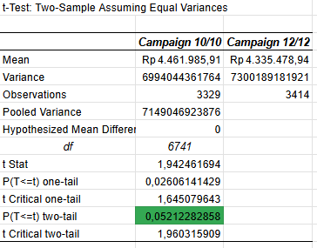
5. Hypothesis Testing
Question
B. Is there any significant difference between campaign 10/10 and campaign 12/12 Total Revenue ?
Answer
1. Hypothesis :
H0: There is no significant difference in total revenue between Campaign 10/10 and Campaign 12/12
H1: There is significant difference in total revenue between Campaign 10/10 and Campaign 12/12
2. Alpha (0.05 or 5%)
3. Statistical Test (t-Test)
Notes:
ekspektasi (stakeholder) dan realita (problem karena tidak mencapai ekpektasi) dari organisasi dalam mengevaluasi , identifikasi (apa yang diharapkan stakeholder) dan mapping (bahan apa yang diberikan (dataset)), business problem

Slide 24
5. Hypothesis Testing
Question
B. Is there any significant difference between campaign 10/10 and campaign 12/12 Total Revenue ?
Answer
4. Conclusion
P Value (5.21%) > Alpha (5%)
Based on the calculation p-value is above 0.05, which means that we accept H0
Meaning, there is no significant difference in total revenue between Campaign 10/10 and Campaign 12/12
5. Insights
There is no significant difference between mean value of Campaign 10/10 with mean value of Campaign 12/12.
Notes:
ekspektasi (stakeholder) dan realita (problem karena tidak mencapai ekpektasi) dari organisasi dalam mengevaluasi , identifikasi (apa yang diharapkan stakeholder) dan mapping (bahan apa yang diberikan (dataset)), business problem

Slide 25
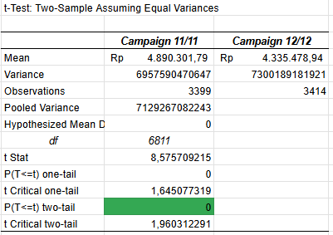
5. Hypothesis Testing
Question
C. Is there any significant difference between campaign 11/11 and campaign 12/12 Total Revenue ?
Answer
1. Hypothesis :
H0: There is no significant difference in total revenue between Campaign 11/11 and Campaign 12/12
H1: There is significant difference in total revenue between Campaign 11/11 and Campaign 12/12
2. Alpha (0.05 or 5%)
3. Statistical Test (t-Test)
Notes:
ekspektasi (stakeholder) dan realita (problem karena tidak mencapai ekpektasi) dari organisasi dalam mengevaluasi , identifikasi (apa yang diharapkan stakeholder) dan mapping (bahan apa yang diberikan (dataset)), business problem

Slide 26
5. Hypothesis Testing
Question
C. Is there any significant difference between campaign 11/11 and campaign 12/12 Total Revenue ?
Answer
4. Conclusion
P Value (0.00%) < Alpha (5%)
Based on the calculation p-value is below 0.05, which means that we reject H0
Meaning, there is significant difference in total revenue between Campaign 11/11 and Campaign 12/12
5. Insights
There is a significant decrease between mean value of Campaign 11/11 with mean value of Campaign 12/12.
Notes:
ekspektasi (stakeholder) dan realita (problem karena tidak mencapai ekpektasi) dari organisasi dalam mengevaluasi , identifikasi (apa yang diharapkan stakeholder) dan mapping (bahan apa yang diberikan (dataset)), business problem

Slide 27
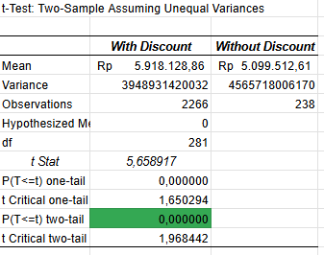
5. Hypothesis Testing
Question
D. Is there any significant difference between Men’s Fashion with discount and Men’s Fashion without discount Total Revenue ?
Answer
1. Hypothesis :
H0: Amount of Total Revenue Men's Fashion with discount = Amount of Total Revenue Men's Fashion without discount
H1: Amount of Total Revenue Men's Fashion with discount != Amount of Total Revenue Men's Fashion without discount
2. Alpha (0.05 or 5%)
3. Statistical Test (t-Test)
Notes:
ekspektasi (stakeholder) dan realita (problem karena tidak mencapai ekpektasi) dari organisasi dalam mengevaluasi , identifikasi (apa yang diharapkan stakeholder) dan mapping (bahan apa yang diberikan (dataset)), business problem

Slide 28
5. Hypothesis Testing
Question
D. Is there any significant difference between Men’s Fashion with discount and Men’s Fashion without discount Total Revenue ?
Answer
4. Conclusion
P Value (0.00%) < Alpha (5%)
Based on the calculation p-value is below 0.05, which means that we reject H0
Meaning, Amount of Total Revenue with discount != Amount of Total Revenue without discount
5. Insights
Providing discounts on men's fashion products will make a significant change to total revenue.
Notes:
ekspektasi (stakeholder) dan realita (problem karena tidak mencapai ekpektasi) dari organisasi dalam mengevaluasi , identifikasi (apa yang diharapkan stakeholder) dan mapping (bahan apa yang diberikan (dataset)), business problem

Slide 29
5. Hypothesis Testing
Question
E. What is the insights and business recommendation based on Hypothesis Testing ?
Answer
The business recommendation :
Campaign 12/12 could generate higher revenue if the discount budget is increased. Since it has already demonstrated high ROI with limited discounts, increasing the budget could potentially drive even more transactions and customers. This could help boost total revenue while still maintaining efficient spending on discounts.
Given its high sales volume and relatively low discount allocation, Men’s Fashion represents a key opportunity. By targeting Men’s Fashion more aggressively with higher discounts, the campaign could see even greater total revenue.
To maximize the efficiency of discounts, ensure that discounts are applied to high-quantity, low-price items (such as products in the Superstore category). By being more strategic in which products are discounted, the business can drive higher volumes without compromising profitability.
Since Men’s Fashion has high potential, consider creating targeted campaigns specifically around this category. Offer larger discounts during off-peak seasons or when there are high stock levels to clear. This could further increase revenue and transaction volume while maintaining a high ROI.
Notes:
ekspektasi (stakeholder) dan realita (problem karena tidak mencapai ekpektasi) dari organisasi dalam mengevaluasi , identifikasi (apa yang diharapkan stakeholder) dan mapping (bahan apa yang diberikan (dataset)), business problem

Slide 30
5. Hypothesis Testing
Question
E. What is the insights and business recommendation based on Hypothesis Testing ?
Answer
The business recommendation :
Focus on high-volume products with lower price points to test if increased discounts can drive higher sales and ROI. Even though products in categories like Men’s Fashion have a low average discount, they could yield more significant returns if discounts are increased efficiently.
Focus on increasing the discount rate for Men’s Fashion, especially for products with high sales volume. Implement strategies to ensure more transactions in this category receive discounts, which can drive up both sales volume and revenue.
The company should allocate a larger portion of the discount budget to Men’s Fashion, as it is already demonstrating excellent ROI and will have a significant difference in total revenue. This strategic shift could drive further sales without needing to increase the total discount budget dramatically. By concentrating on this category with continuing to provide discounts with a minimum quantity order per transaction.
Notes:
ekspektasi (stakeholder) dan realita (problem karena tidak mencapai ekpektasi) dari organisasi dalam mengevaluasi , identifikasi (apa yang diharapkan stakeholder) dan mapping (bahan apa yang diberikan (dataset)), business problem

